Slide 1
How to Publish with IEEE
Name
Title
Date

Slide 2
Publish with IEEE by following four main steps
Choose an IEEE periodical
Prepare your manuscript
Submit your article
Review process
Choose
Prepare
Submit
Review
Notes:
You can publish with IEEE by following four main steps.
Choose the appropriate IEEE periodical for your research.
Prepare your manuscript using IEEE standards.
Submit your article via E-Submission process.
And, the review process once your article has been submitted.

Slide 3
Choose Publish your research where it will have the most impact
Scope &
Readership
Subject/Topic scope
Audience type
Periodical
Availability
Cost-Effectiveness
Open Access
Prestige
Impact Factor
Eigenfactor™ Score
Article Influence™ Score
Notes:
Publish your research in the IEEE periodical or transaction where it will have the most impact.
Base your decision by looking at several different factors:
- Does the scope and audience of the periodical line up well with my research? Will I get the readership that’s right for my research?
- How prestigious is the periodical? Look at the Impact Factor, Eigenfactor, and Article Influence scores—all three measure how a periodical or transaction ranks in comparison to its peers. Go to http://www.ieee.org/periodicalcitations.html to learn more.
- How available is the periodical? Look at the periodical cost-effectiveness, which provides the cost per article for fee-based periodicals. In general, the more expensive a periodical, the less available it will be to your audience.
- Finally, consider publishing in open access periodicals that will be available to a wider audience.

Slide 4
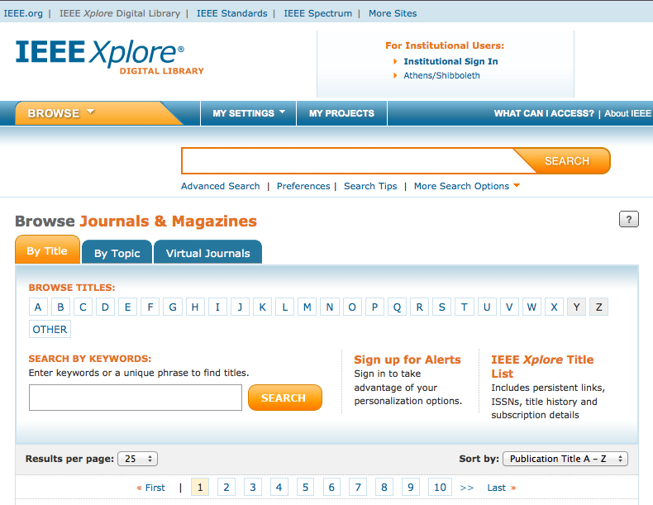
Choose Find periodicals in IEEE Xplore®
Browse by Title or Topic to find the periodical that’s right for your research
Notes:
To find a periodical on IEEE Xplore, you can browse by title or you can narrow the periodicals by topic.

Slide 5
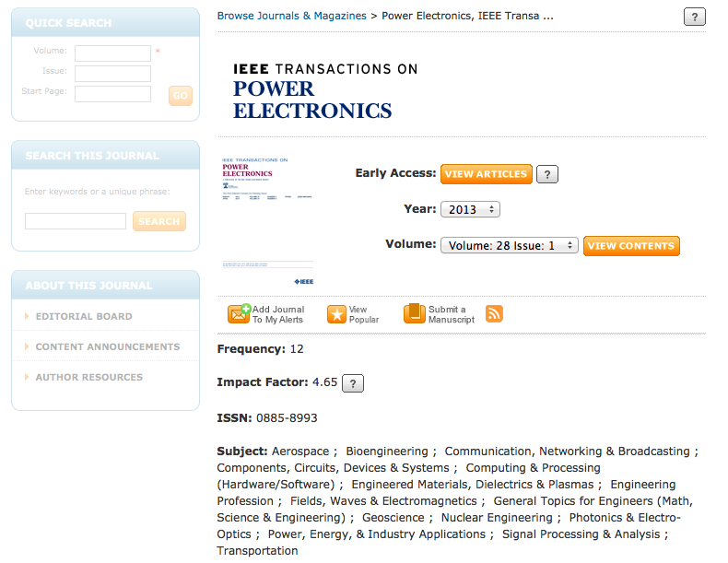
Choose Find periodicals in IEEE Xplore®
Find details on each IEEE periodical’s homepage
5
10/18/2012
Notes:
Once you select a periodical, you will find the aim and scope of the periodical, publication details, content announcements, and author resources on each periodical’s homepage.

Slide 6
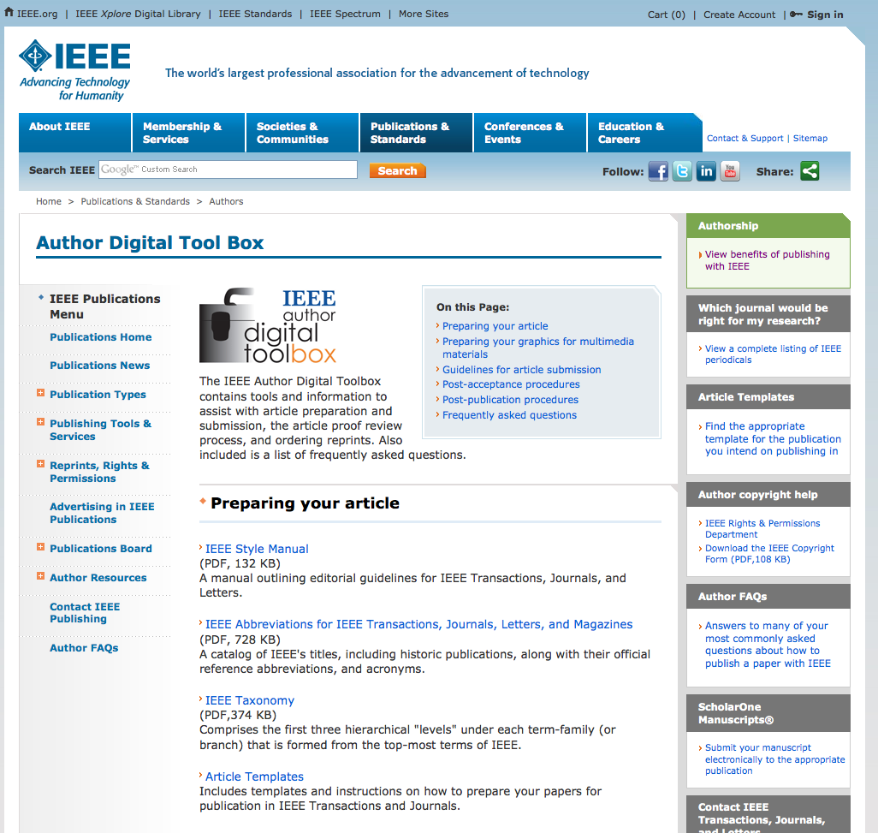
Prepare IEEE Author Digital Toolbox
A robust resource with tools to prepare your manuscript for publication
IEEE Style Manual
Reference Preparation Assistant
Editing Assistance
Templates
Instructions for submitting multimedia materials
Notes:
The IEEE Author Digital Toolbox contains tools and information to ensure that you get all the information you need to prepare your manuscript for publication.
The IEEE Style Manual provides editorial guidelines for all IEEE transactions, periodicals, and letters.
There is also a tool for validating references, an IEEE PDF Checker, and the IEEE Editing Assistance program to refine the use of English in your manuscript, along with other information.
Templates and instructions for how to prepare articles are included for all IEEE periodicals and transactions.
You will also find tips for how to prepare multimedia materials for publication.
The IEEE Author Digital Toolbox also contains information about submitting articles, the article proof review process, and ordering reprints.

Slide 7
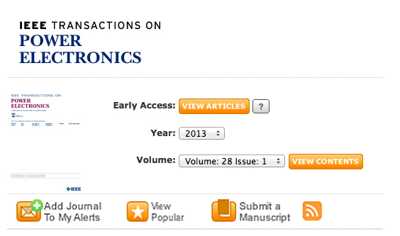
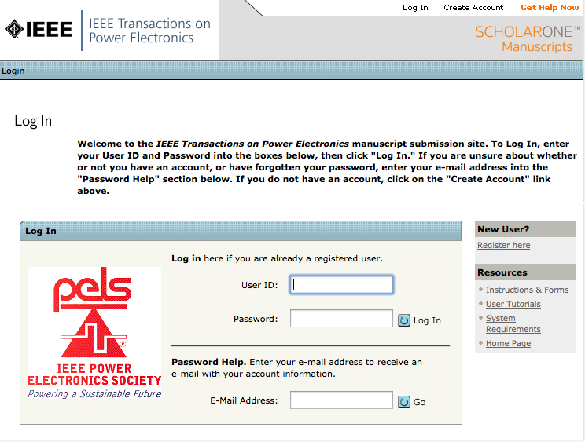
Submit The submission process is easy through IEEE Xplore
Follow the prompts
to set up an account
Click “Submit a
Manuscript”
Notes:
The submission process is easy through IEEE Xplore.
To submit an article to an IEEE periodical or transaction, go to that publication’s homepage in IEEE Xplore.
Click on “Submit a Manuscript” and follow the prompts to set up an account.

Slide 8
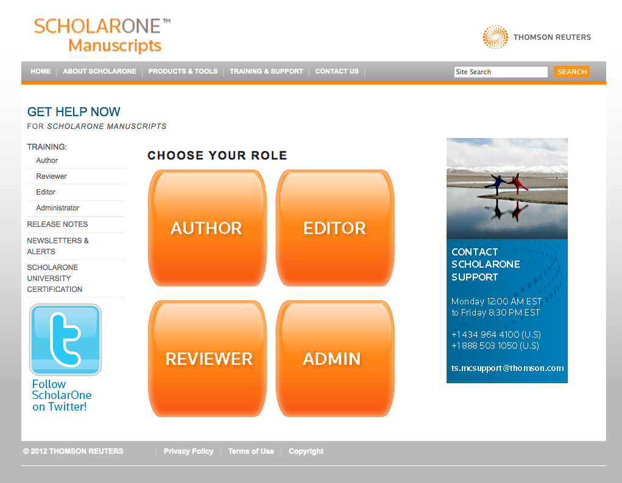
Submit Start at ScholarOne Manuscripts Help Center for training and FAQs
http://mchelp.manuscriptcentral.com/gethelpnow/
Notes:
The IEEE Web-based workflow includes electronic submission via ScholarOne Manuscripts. You will start here, at the Help Center by clicking “Author.”
This process has shortened the time from submission to IEEE publication. It also helps authors track a paper’s progress.
For questions, go to the URL at the bottom of the screen.
.

Slide 9
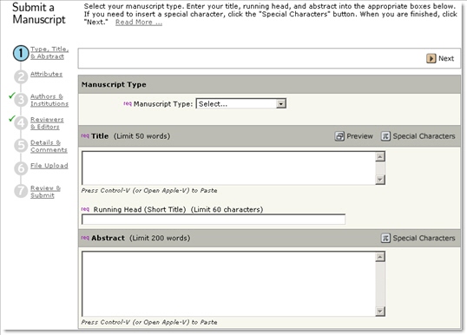
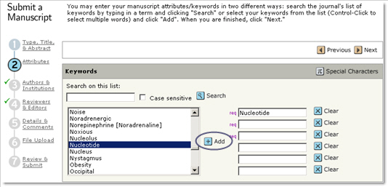
Submit To submit an article, follow the on-screen directions
1 Type, Title & Abstract
2 Attributes /
Keywords
Notes:
Now you are in the author center. To submit an article, follow the on-screen directions through the process. The progress bar on the side of the page shows when each step of the submission process is complete.
The IEEE ScholarOne author center will guide you through seven steps to submission. The first two are:
Type, Title & Abstract, Attributes/Keyword selection

Slide 10
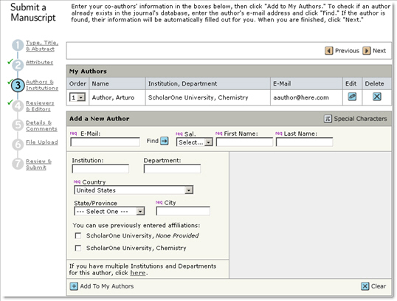
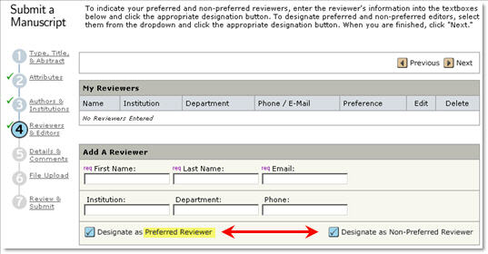
Submit To submit an article, follow the on-screen directions
3 Authors & Institutions
4 Reviewers
& Editors
10
10/18/2012
Notes:
The next two sections are: Authors & Institutions, Reviewers & Editors

Slide 11
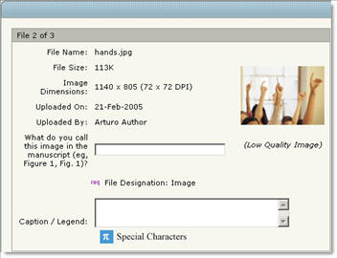
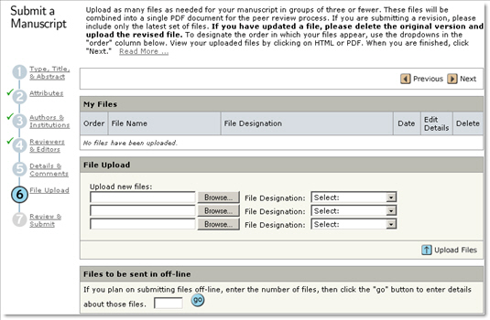
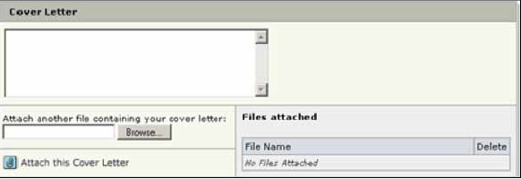
Submit To submit an article, follow the on-screen directions
5 Details & Comments
6 File Upload
This page is periodical-specific and may include an area for a cover letter, as well as any other required submission information.
11
10/18/2012
Notes:
Steps 5 and 6 lead you through Details & Comments, and File Upload.
.

Slide 12
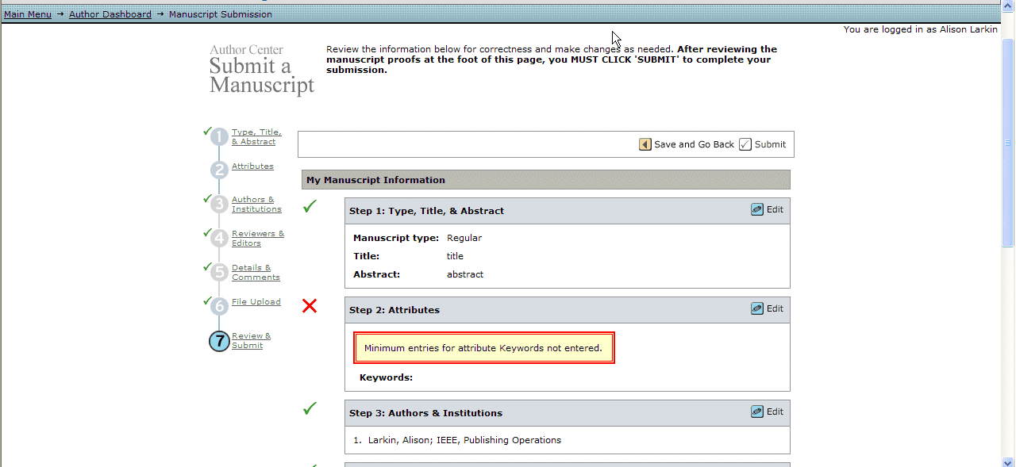
Submit The final step is review and submit
Clicking submit
finalizes the process
You will be alerted
to any missing items
7 Review & Submit
12
10/18/2012
Notes:
The final step is to Review & Submit.
You will be alerted to any missing items before you submit your article.
Clicking submit finalizes the process.
12

Slide 13
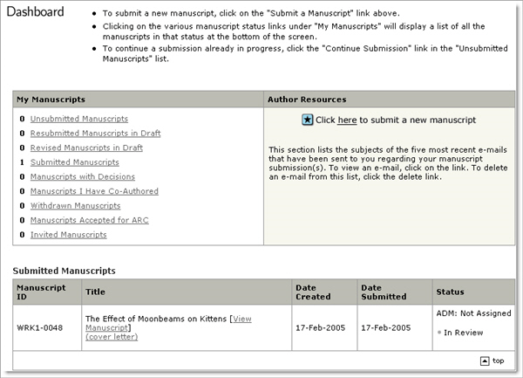
Submit Check the status of your review
Track status and view the details of your manuscripts on the Author Dashboard.
Select the appropriate queue in the My Manuscripts section.
The results will display directly below the dashboard.
13
10/18/2012
Notes:
You can check the status of any manuscript you have in review via the dashboard.
13

Slide 14
Review The Review Process
Paper received
Sent to Editor-in-Chief
Assigned to Associate Editor
Reviewers contacted
Reviewers accept task
When the reviews are received, the Associate Editor makes a recommendation to the Editor-in-Chief
Editor-in-Chief makes final decision
The steps in this review process vary by publication.
14
10/18/2012
Notes:
Once an article is submitted, the review process begins. The IEEE peer review process is designed to ensure the high quality of every article submitted to and published by IEEE.
The Paper is received,
Sent to Editor-in-Chief,
Assigned to Associate Editor,
Reviewers are contacted,
Reviewers accept the task,
When the required number of reviews are received, the Associate Editor makes a recommendation to the Editor-in-Chief,
Editor-in-Chief makes final decision.
The steps in this review process vary by publication, and the author can track progress of the review through ScholarOne Manuscripts for most publications.
14

Slide 15
Review Possible review decisions
ACCEPT: Congratulations! The paper now is entered into a production process.
ACCEPT WITH MINOR CORRECTIONS: One or more of the referees have made suggestions for improvement.
RESUBMIT: The paper has major deficiencies that could be repaired by the author.
REJECT: If you have a rejection from a top publication, you can try submitting the paper to a less prestigious publication.
Notes:
Possible Review Decisions can be:
ACCEPT: Congratulations! The paper now is entered into a production process.
ACCEPT WITH MINOR CORRECTIONS: This is the most common form for acceptance. One or more of the referees have made suggestions for improvement. Only minor changes are needed.
RESUBMIT: The paper has major deficiencies that could be repaired by the author according to the referees. You can resubmit after you have addressed the problems.
REJECT: If you have a rejection from a top publication (IEEE Transactions, for example), you can try submitting the paper to a less prestigious publication.

Slide 16
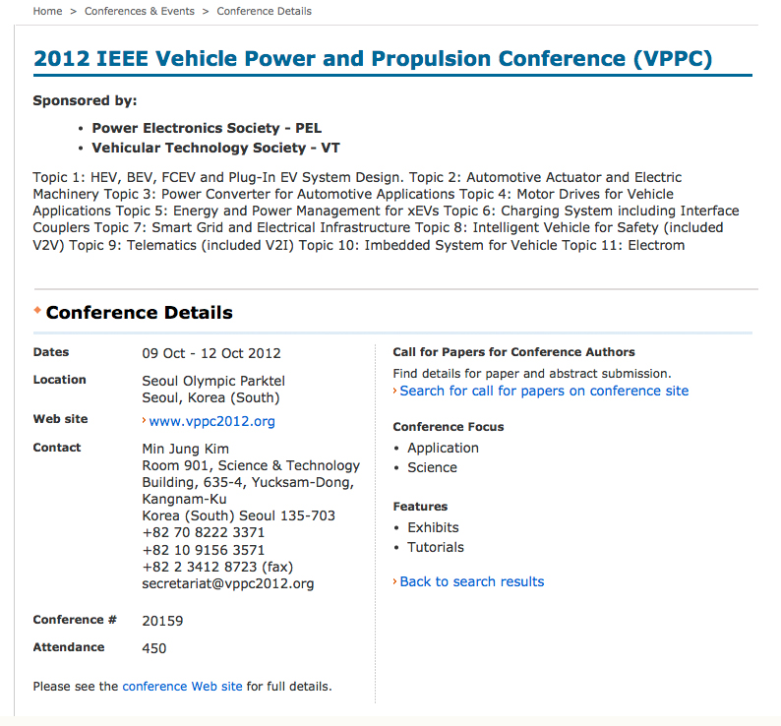
Publishing with IEEE Conferences
Each IEEE sponsored conference has its own requirements for publishing.
For complete information, see the Call for Papers for the conference in question.
To search for a specific conference, go to the main Conferences & Events
page on www.ieee.org
Notes:
Unlike periodicals that are managed by IEEE, the process for submitting papers to IEEE sponsored conferences varies from conference to conference.
For complete information, please see the “Call for Papers” for the conference(s) in question. There you will find information about submission and review dates, acceptable formats for submission, and presentation requirements for accepted papers.
To search for a specific conference, go the main Conferences & Events page on ieee.org.

Slide 17
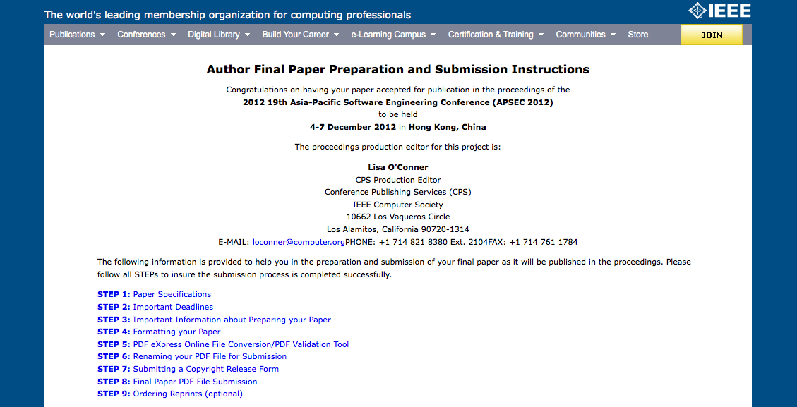
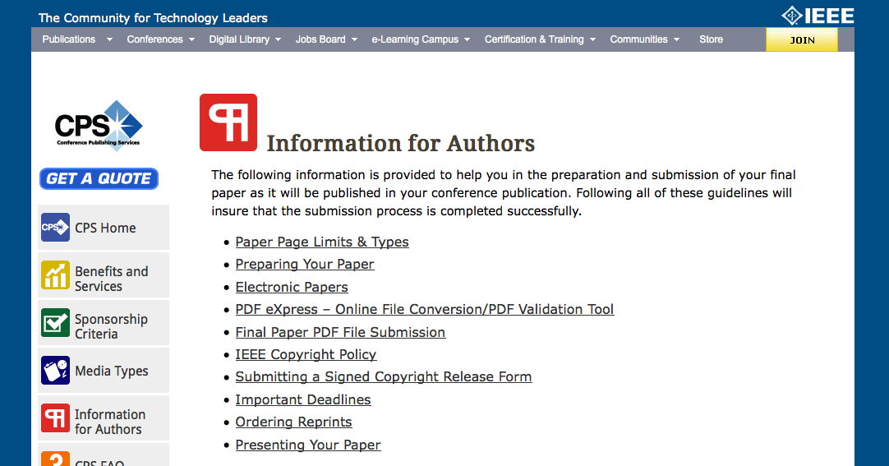
Author final paper preparation and submission instructions
If your paper is accepted to an IEEE sponsored conference, you will receive final submission instructions.
For general information for authors, go to the conference sponsor’s information page.
Notes:
If your paper is accepted to an IEEE sponsored conference, you will receive submission instructions from a conference editor or volunteer.
The author is supplied with a link to follow and must enter certain information into a Web-based form. The instructions will take the author through step by step, providing links to templates, directions for PDF eXpress, etc., and also asks you to submit an e-copyright form.
For general information for authors, go to the conference sponsor’s information page.

Slide 18
Thank You.
IEEE would like you to reach your full potential as a published author.
Visit www.ieee.org/go/authorship
Browse www.ieee.org/ieeexplore
Notes:
IEEE would like you to reach your full potential as a published author.
I'd like to invite you to visit our Authors page on ieee.org.
Also, feel free to browse the IEEE Xplore digital library. As an IEEE author, you will see that you are among very good company. Thank you.

