Slide 1
IEEE作者指南
姓名
职务
日期

Slide 2
按以下4个主要步骤在IEEE发表您的论文
选择一个IEEE的期刊
撰写 论文
提交 论文
同行评议 过程
选择
撰写
投稿
同行评议
Notes:
You can publish with IEEE by following four main steps.
Choose the appropriate IEEE periodical for your research.
Prepare your manuscript using IEEE standards.
Submit your article via E-Submission process.
And, the review process once your article has been submitted.

Slide 3
选择 在影响力最大的媒介上出版您的研究成果
期刊的可获取性
低成本
开放获取
权威性
影响因子
“特征因子”™
“文章影响力”™
学科领域与读者群
学科/学术领域
读者类型
Notes:
Publish your research in the IEEE periodical or transaction where it will have the most impact.
Base your decision by looking at several different factors:
- Does the scope and audience of the periodical line up well with my research? Will I get the readership that’s right for my research?
- How prestigious is the periodical? Look at the Impact Factor, Eigenfactor, and Article Influence scores—all three measure how a periodical or transaction ranks in comparison to its peers. Go to http://www.ieee.org/periodicalcitations.html to learn more.
- How available is the periodical? Look at the periodical cost-effectiveness, which provides the cost per article for fee-based periodicals. In general, the more expensive a periodical, the less available it will be to your audience.
- Finally, consider publishing in open access periodicals that will be available to a wider audience.

Slide 4
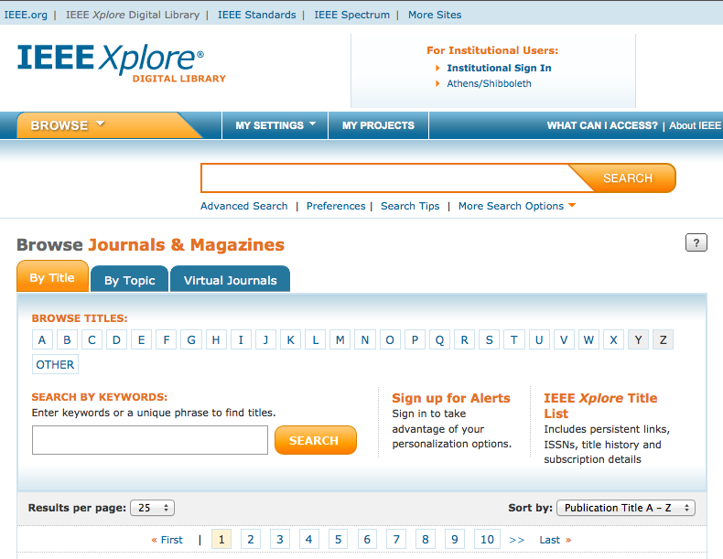
选择 在IEEE Xplore® 平台上搜索期刊
按照期刊名和学科浏览，找到您所在研究领域的期刊
Notes:
To find a periodical on IEEE Xplore, you can browse by title or you can narrow the periodicals by topic.

Slide 5
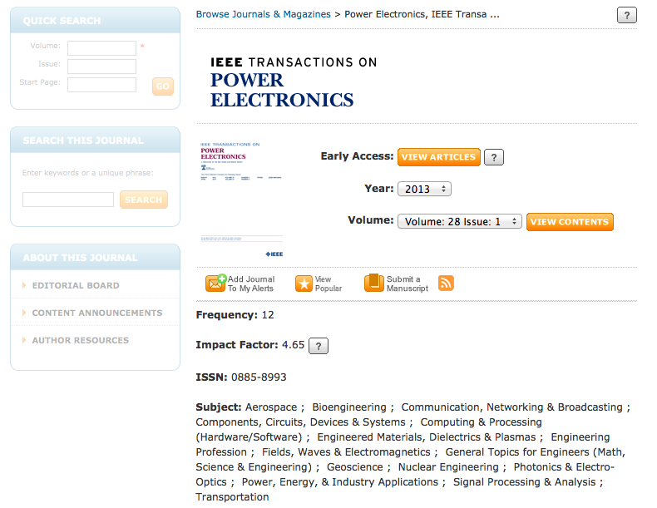
选择 在IEEE Xplore®平台上找到相关期刊
在IEEE各个期刊的主页上查询该刊的详细信息
5
1/23/13
Notes:
Once you select a periodical, you will find the aim and scope of the periodical, publication details, content announcements, and author resources on each periodical’s homepage.

Slide 6
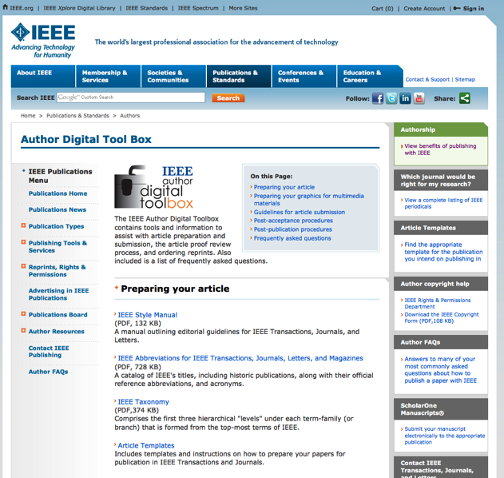
撰写 IEEE 作者数字工具箱
这些工具可为您撰写论文提供得力帮助
IEEE 文体手册
参考文献助手
编辑助手
模板
提交多媒体材料指南
Notes:
The IEEE Author Digital Toolbox contains tools and information to ensure that you get all the information you need to prepare your manuscript for publication.
The IEEE Style Manual provides editorial guidelines for all IEEE transactions, periodicals, and letters.
There is also a tool for validating references, an IEEE PDF Checker, and the IEEE Editing Assistance program to refine the use of English in your manuscript, along with other information.
Templates and instructions for how to prepare articles are included for all IEEE periodicals and transactions.
You will also find tips for how to prepare multimedia materials for publication.
The IEEE Author Digital Toolbox also contains information about submitting articles, the article proof review process, and ordering reprints.

Slide 7
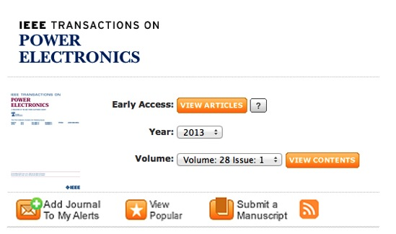
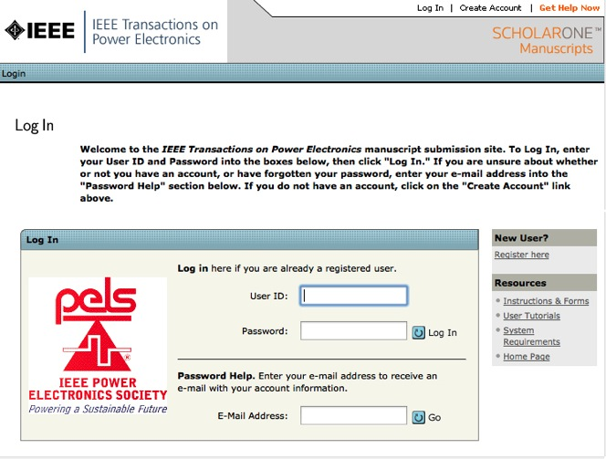
投稿 在IEEE Xplore上投稿简单省力
按照提示设立一个帐号
点击 “Submit a
Manuscript”
Notes:
The submission process is easy through IEEE Xplore.
To submit an article to an IEEE periodical or transaction, go to that publication’s homepage in IEEE Xplore.
Click on “Submit a Manuscript” and follow the prompts to set up an account.

Slide 8
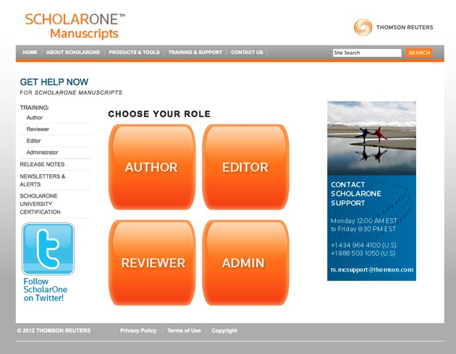
投稿 先访问ScholarOne Manuscripts Help Center接受培训，了解常见问题
http://mchelp.manuscriptcentral.com/gethelpnow/
Notes:
The IEEE Web-based workflow includes electronic submission via ScholarOne Manuscripts. You will start here, at the Help Center by clicking “Author.”
This process has shortened the time from submission to IEEE publication. It also helps authors track a paper’s progress.
For questions, go to the URL at the bottom of the screen.
.

Slide 9
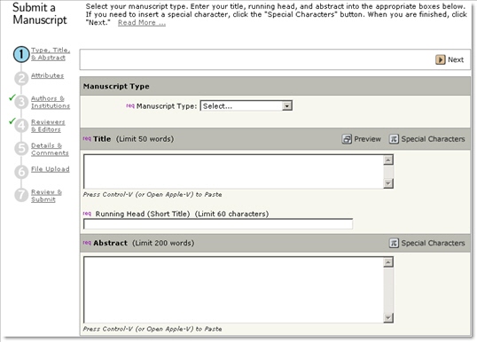
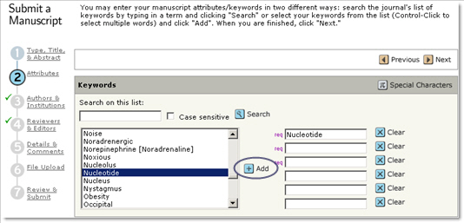
投稿 按照屏幕上的指示提交稿件
1 类型，题目以及
摘要
2 出处 /
关键词
Notes:
Now you are in the author center. To submit an article, follow the on-screen directions through the process. The progress bar on the side of the page shows when each step of the submission process is complete.
The IEEE ScholarOne author center will guide you through seven steps to submission. The first two are:
Type, Title & Abstract, Attributes/Keyword selection

Slide 10
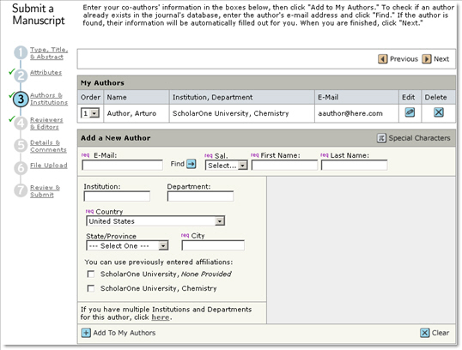
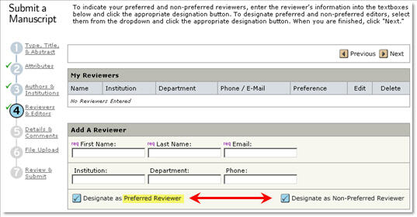
投稿 按照屏幕上的指示提交稿件
3 作者及作者所
在单位
4 审稿人和
编辑
10
1/23/13
Notes:
The next two sections are: Authors & Institutions, Reviewers & Editors

Slide 11
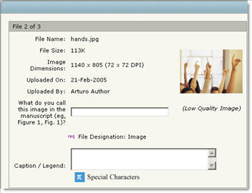
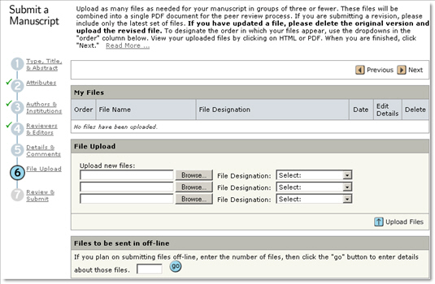
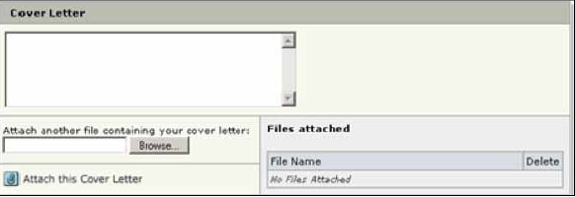
投稿 按照屏幕上的指示提交稿件
5 细节和其他
注意事项
6 上传文件
This page is periodical-specific and may include an area for a cover letter, as well as any other required submission information.
11
1/23/13
Notes:
Steps 5 and 6 lead you through Details & Comments, and File Upload.
.

Slide 12
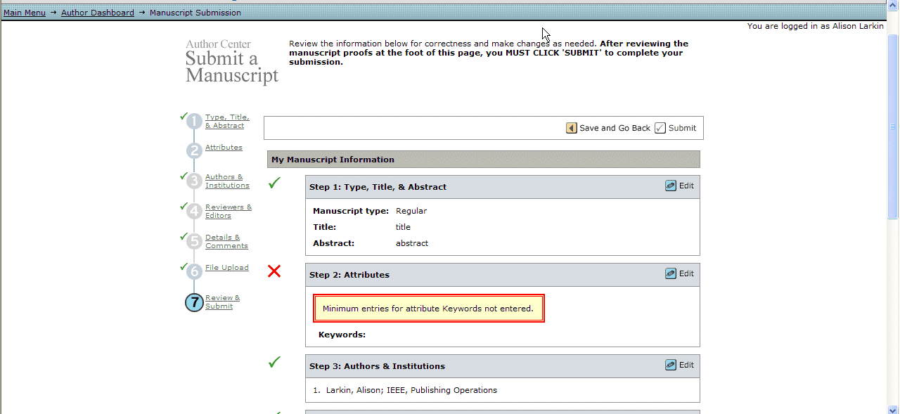
投稿 最后一个步骤：审核后提交
点击“提交”，完成投
稿过程
如果漏填了某些项目，
系统会予以提醒
7 检查后
提交
12
1/23/13
Notes:
The final step is to Review & Submit.
You will be alerted to any missing items before you submit your article.
Clicking submit finalizes the process.
12

Slide 13
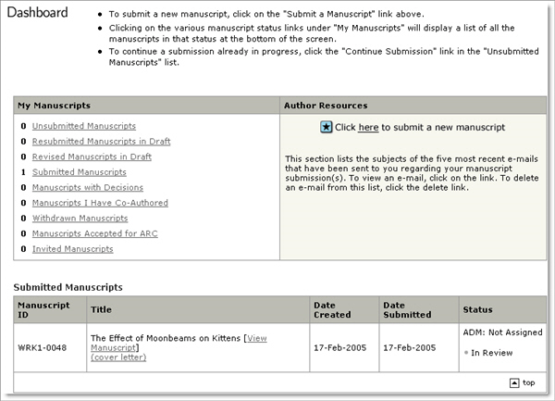
投稿 查看文章的审核状态
在Author Dashboard上追踪进程并查看您所投文章的详细情况。
在My Manuscripts页面上选择要查询的内容
查询结果会直接显示在dashboard的下方
13
1/23/13
Notes:
You can check the status of any manuscript you have in review via the dashboard.
13

Slide 14
审稿 审稿的过程
收到投稿
将稿件发给总编
分配给副主编
联系审稿专家
审稿专家接受审稿任务
收到审稿意见后，副主编向主编进行推荐
主编做出最终决定
各期刊的审稿步骤会有所差异
14
1/23/13
Notes:
Once an article is submitted, the review process begins. The IEEE peer review process is designed to ensure the high quality of every article submitted to and published by IEEE.
The Paper is received,
Sent to Editor-in-Chief,
Assigned to Associate Editor,
Reviewers are contacted,
Reviewers accept the task,
When the required number of reviews are received, the Associate Editor makes a recommendation to the Editor-in-Chief,
Editor-in-Chief makes final decision.
The steps in this review process vary by publication, and the author can track progress of the review through ScholarOne Manuscripts for most publications.
14

Slide 15
审稿 可能的审稿决定
接受: 祝贺您! 您的论文将进入生产加工流程
接受，但要做小的修改: 一个或多个审稿专家提出修改建议。
重新投稿: 论文存在较大的缺陷，需要作者予以修改。
拒绝: 如果论文被一家权威出版物拒绝，您可尝试把论文投向其他门槛相对较低的出版物。
Notes:
Possible Review Decisions can be:
ACCEPT: Congratulations! The paper now is entered into a production process.
ACCEPT WITH MINOR CORRECTIONS: This is the most common form for acceptance. One or more of the referees have made suggestions for improvement. Only minor changes are needed.
RESUBMIT: The paper has major deficiencies that could be repaired by the author according to the referees. You can resubmit after you have addressed the problems.
REJECT: If you have a rejection from a top publication (IEEE Transactions, for example), you can try submitting the paper to a less prestigious publication.

Slide 16
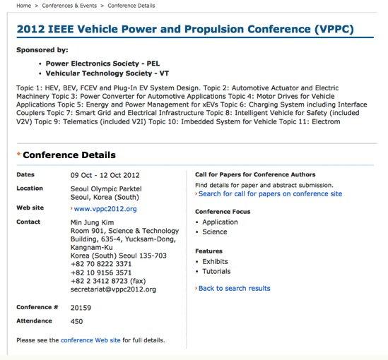
在IEEE会议上发表您的论文
每一个IEEE举办的会议对出版有不同的要求
如果对某个会议的投稿有疑问，请参见该会议的约稿函，了解详情。
要查询某个具体会议，请访问
www.ieee.org 网站上的Conferences
& Events主页。
Notes:
Unlike periodicals that are managed by IEEE, the process for submitting papers to IEEE sponsored conferences varies from conference to conference.
For complete information, please see the “Call for Papers” for the conference(s) in question. There you will find information about submission and review dates, acceptable formats for submission, and presentation requirements for accepted papers.
To search for a specific conference, go the main Conferences & Events page on ieee.org.

Slide 17
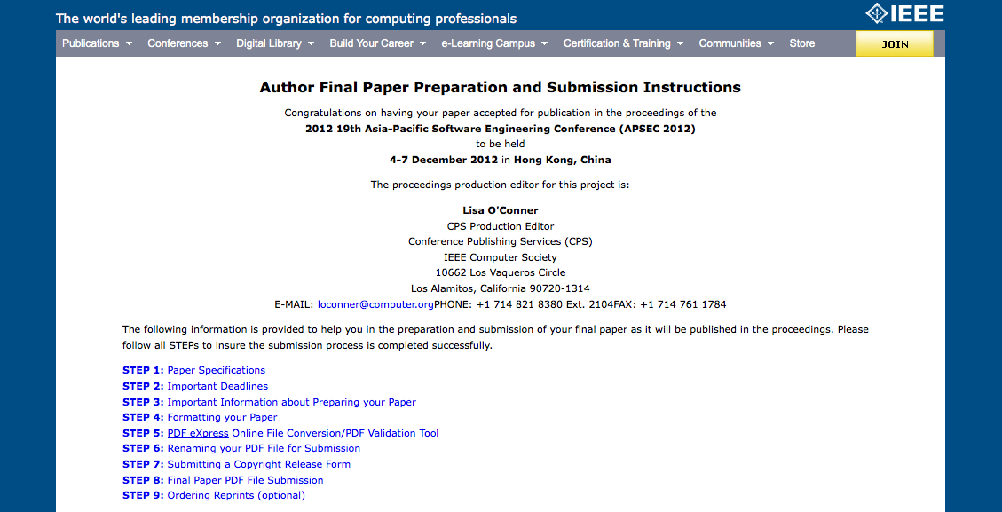
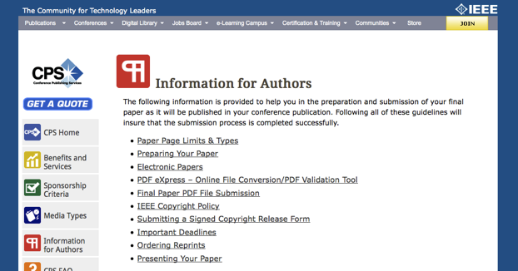
会议论文被录用后的步骤
如果文章被IEEE主办的会议接受，您将会收到如何完成最终投稿的信息。
欲了解会议投稿的其他信息，请访问会议主办方相关网页。
Notes:
If your paper is accepted to an IEEE sponsored conference, you will receive submission instructions from a conference editor or volunteer.
The author is supplied with a link to follow and must enter certain information into a Web-based form. The instructions will take the author through step by step, providing links to templates, directions for PDF eXpress, etc., and also asks you to submit an e-copyright form.
For general information for authors, go to the conference sponsor’s information page.

Slide 18
谢谢
IEEE期待您成功发表论文，实现自己的价值。
欲了解更多信息，请访问 www.ieee.org/go/authorship
www.ieee.org/ieeexplore
Notes:
IEEE would like you to reach your full potential as a published author.
I'd like to invite you to visit our Authors page on ieee.org.
Also, feel free to browse the IEEE Xplore digital library. As an IEEE author, you will see that you are among very good company. Thank you.

